Slide 1
TTL PRIVACY
Human Computer Interaction Fall ‘17 - Team 4
Satyajit Deshmukh – 1001417727
Aditya Aditya – 1001419672
Aditya Pandey - 1001405034

Slide 2
Abstract
Communication is the basic need of today’s world. With the evolution of internet the end to end point communication using various electronic means is no longer safe. Eavesdropping and man in the middle attack is quite common now a days to prevent it we came with the idea of TTL(Time to Live).
The basic idea of Time to Live Privacy Application (TTL) is to develop a secure means of communication between its users to maintain integrity and confidentiality of the message. TTL is one of it’s kind of messenger that overcomes the problem of safe communication by using a unique algorithm of time to live for the messages.

Slide 3
• Introduction
To develop a secret means of communication between its users to maintain the integrity and confidentiality of the message using the concept of expiry of portal and the message after the defined period of time by the creator.
A unique method for users to communicate securely.
Prevent Man-in-the-middle attacks using endpoint authentication.
Limited Number of access to messages by the user of the portal.
Time To Live for each portal of the message.

Slide 4

Project Timeline
Phase 1st : Studying the feasibility and past
development in this field.
Phase 2nd : Select the user and selecting the target
audience, features and studying. Taking
the best out of conventional Sources.
Phase 3rd : Designing the framework and functionality
of the project.
Phase 4th : Start working on the designing and start
coding of the project.
Phase 5th : Design and evaluation of test cases with a
handful of users.
Phase 6th : Final evaluation and presentation of the
project.

Slide 5
Methodology/ Technology used
Frontend: HTML, Handlebars, CSS,
Templating engine: mustache.js //{{mustache}}
Frontend to backend server calls: Ajax
Frontend Authentication and Minimal Backend Authentication: passport.js
Backend: Node.js, express.js framework

Slide 6
Related Work and Background
The research papers that helped us in the improvising the idea of TTL are-
Humans in the loop: human-computer interaction and security.
Secure Snaps: A New Forward Secrecy Cryptosystem for Self-Destructing Messages in Mobile Services.
HCI and security systems.
Human-Computer Interaction and Visualization.

Slide 7
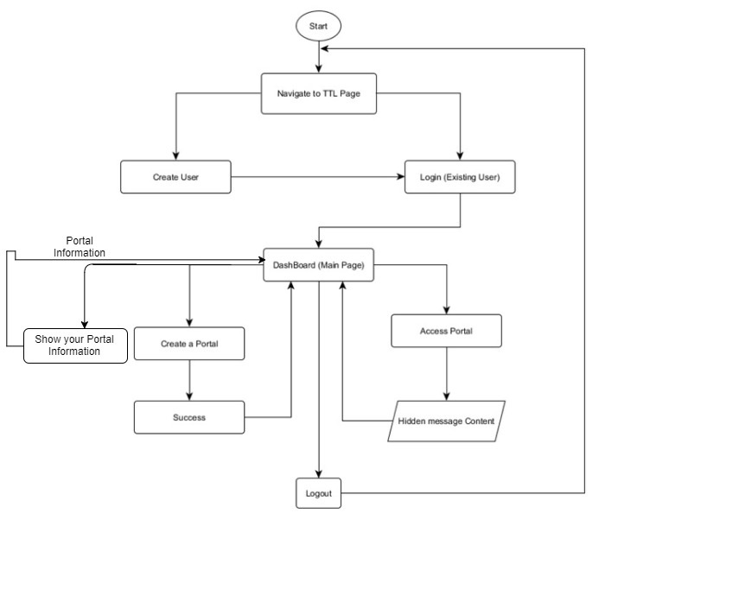
Activity Flow Diagram

Slide 8
DEMO

Slide 9
• Experimental and Evaluation Plan
We used the Natural Settings involving users approach to evaluate the project.
In this we choose a number of users who created different portals and tried to access the messages and creation of portal .
some users tried to access the portals they don’t have access rights and will tried to distort the messages.
User Survey link to study the response towards TTL- https://docs.google.com/forms/d/1tKx48Qep8Z4T2GwBirNYS_UY6CdKo-cteXek_DpTSRk/edit?ts=5a1cf1df

Slide 10
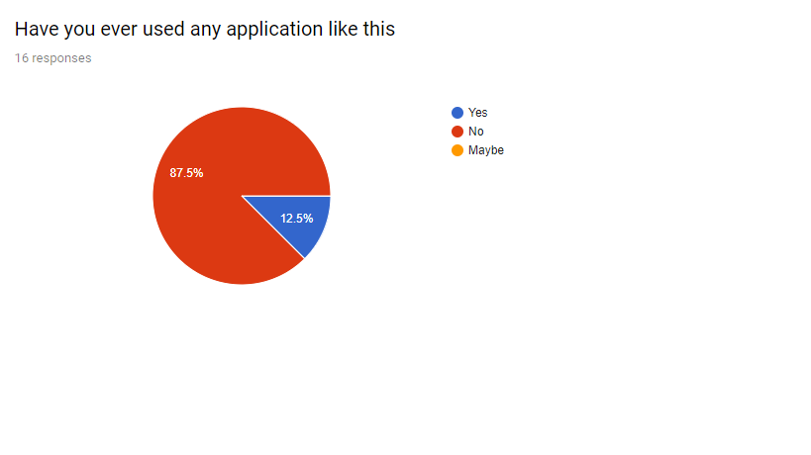
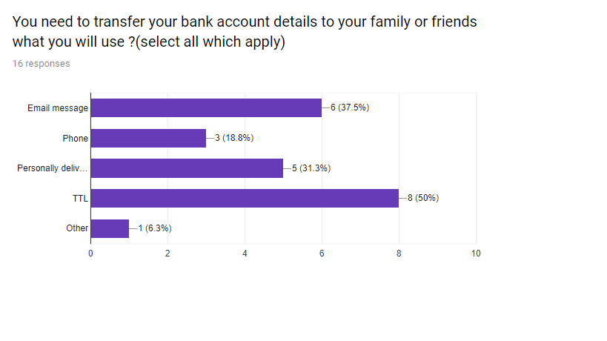
Results of Survey

Slide 11
Discussion and Future Work
There is a wide scope for this application in near future with the increase in number of Cyber attacks.
In future we can add functionality to transfer images and multimedia and files.
In the current scenario it is a desktop application but in near future we can get it for mobile devices such as smartphones and tablets.

Slide 12
Roles And Responsibilities
Frontend (UI Design): Satyajit Deshmukh
Designing HTML page for TTL Privacy Application using Handlebar, jQuery and Mustache.js
CSS, Bootstrap, HTML – Adtiya Aditya
Backend Authentication/ Database Calls: Aditya Pandey
Minimal frontend authentication, backend Authentication,
Overall Work Flow/ Conceptual Design: Aditya Aditya/ Satyajit Deshmukh.
Documentation and Presentations : Aditya Aditya

Slide 13

Thank you!

